Slide 1
Pacemaker
Team 7

Slide 2
Table of Contents
Main Problem
Overview: Pacemaker
Key Solution
Existing Solutions
Usage Scenario
System Overview
Specifications
Challenges
Planning
Evaluation Strategy & Success Criteria
Task Designation

Slide 3

Main Problem
Problem
“Running is difficult”
Hard to maintain a consistent, “healthy” pace throughout a run
Easy to lose motivation
Target Users
People who want to lose weight by running
Professional runners who want to beat their record times
Notes:
Target user: 초보러너부터 기록향상을 원하는 러너까지 도움을 줄수 있지만, 초보러너에 좀더 포커싱 함

Slide 4
Overview: Pacemaker
Pace Detection and Adjustment Service
Feedback System for Real-Time Personalized Pace
Gamification Features for Increased Motivation

Slide 5

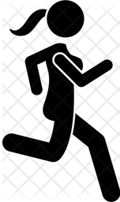

Key Solution
Sensor data
Pace Classification
Real-time Feedback
Slow
Normal
Fast
Step counter
Accelerometer
Heart rate measurement
GPS
Earphone volume adjustment
TTS(Text-To-Speech)
Vibration
Classify user’s pace into three phases
Notes:
Slow, Normal, Fast 를 어떻게 labeling 할 것인지?
구체적 기준
training data 만드는 방식: clustering 알고리즘으로 self-supervised learning 처럼 labeling
(→ 사용자에 관계없이 절대적인 기준을 적용할지 vs. 사용자별로 다른 기준을 적용할지 고민하는 단계)

Slide 6
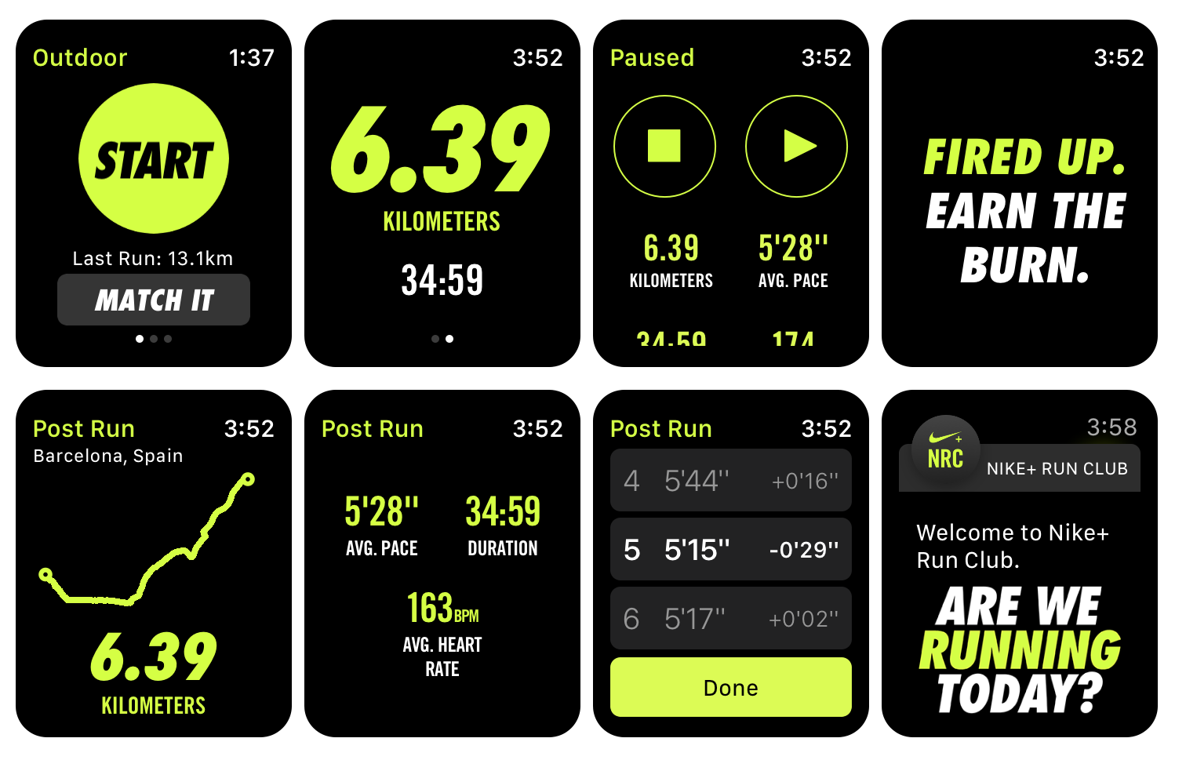
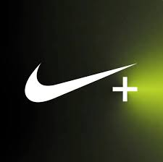
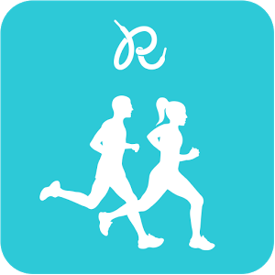


Existing Solutions
Pros:
Keeps track of running pace
Provides voice-assisted coaching
GPS-based tracking
Provides running statistics
Cons:
Feedback is given after the exercise
No real-time feedback
Pace is not personalized during the run

Slide 7
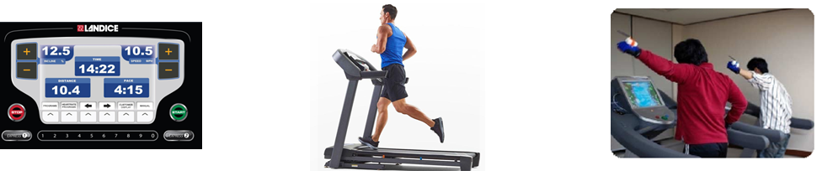
Usage Scenario
Assumption
Outdoor running scenario
A user (runner) w/ mobile & wearable devices (smartphone, smart watch, ear buds, etc.)
There exists pre-defined objective about pace
ex. 30 min. for 5 km
ex. 120~150 bps
Pacemaker operation
Provide instantaneous information about running condition
Give feedback to the user so that it could help maintaining desired pace
Increase motivation by gamification

Slide 8

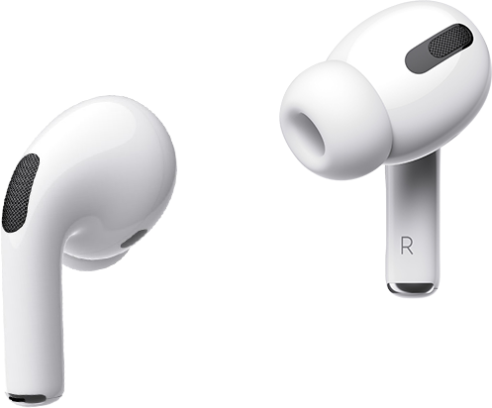
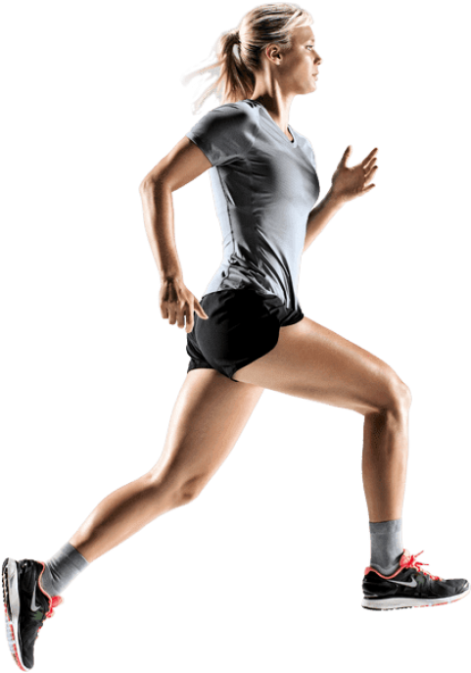
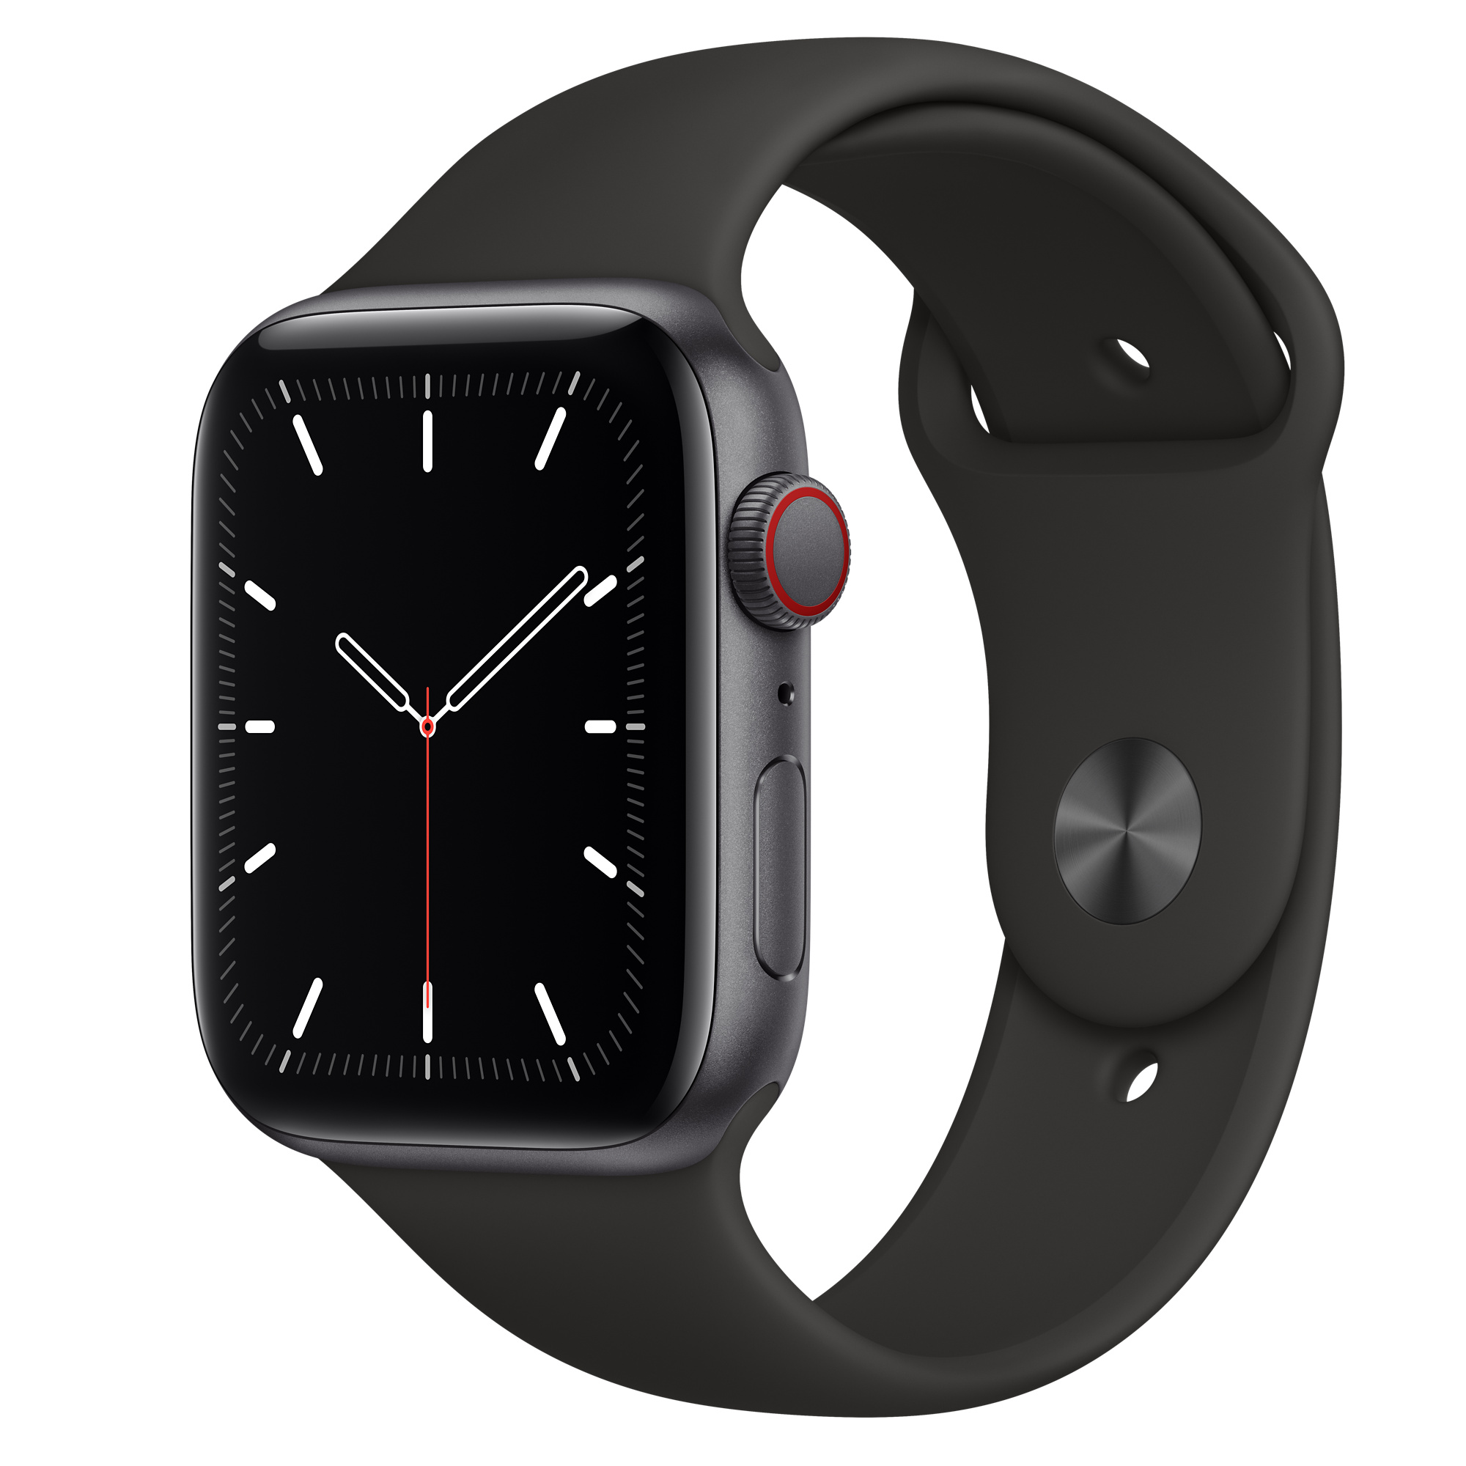
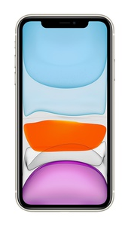
System Overview
Smartwatch Application (Galaxy Watch 4)
Records geological and physical information
Sends information to smartphone
Provides real-time feedback
Smartphone Application (Samsung Galaxy S20)
Calculates optimal pace based on information
Uses ML/DL for good running posture detection
Provide feedback: through earphones or vibration
Gather physical data using smart watch sensors
Use locational query data and smartwatch data to calculate optimal pace with ML
Optional: use data/ML to detect good running posture
Notes:
watch에서 주로 센싱
phone에서 복잡한 계산 담당

Slide 9
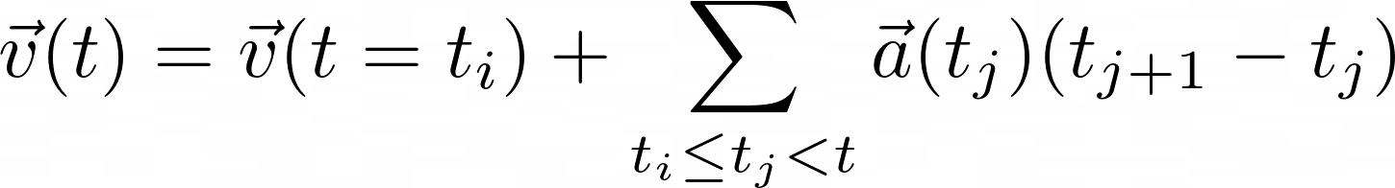
Specifications
We have to use sensors to accurately measure the user’s speed
Ideally, we want instantaneous speeds, not average speeds
Three possible ways
Step counter
Assume person’s stride and calculate the speed
Speed = Step counts * stride / elapsed time
Not an instantaneous speed, highly dependent on strides
Accelerometer
Use acceleration to compute the speed
Need to check the accuracy
GPS
Included in Android GPS functionality
Speed = Distance / elapsed time, based on the coordinates from GPS
Not an instantaneous speed

Slide 10
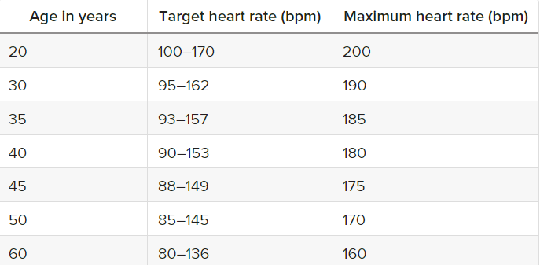
Challenges
Lack of knowledge in fitness
Hard to determine “optimal” pace for individual
Lack of data to train deep neural network model
https://www.healthline.com/health/running-heart-rate#ideal-rate
Technical difficulties
Real-time measurement of the user’s speed using GPS is not so accurate
Jogging causes a lot of movements to the phone, so if we use IMU sensors, filtering such vibrations can be difficult
We will first implement the application with step counter, so we can come back to this problem later if step counter method fails

Slide 11
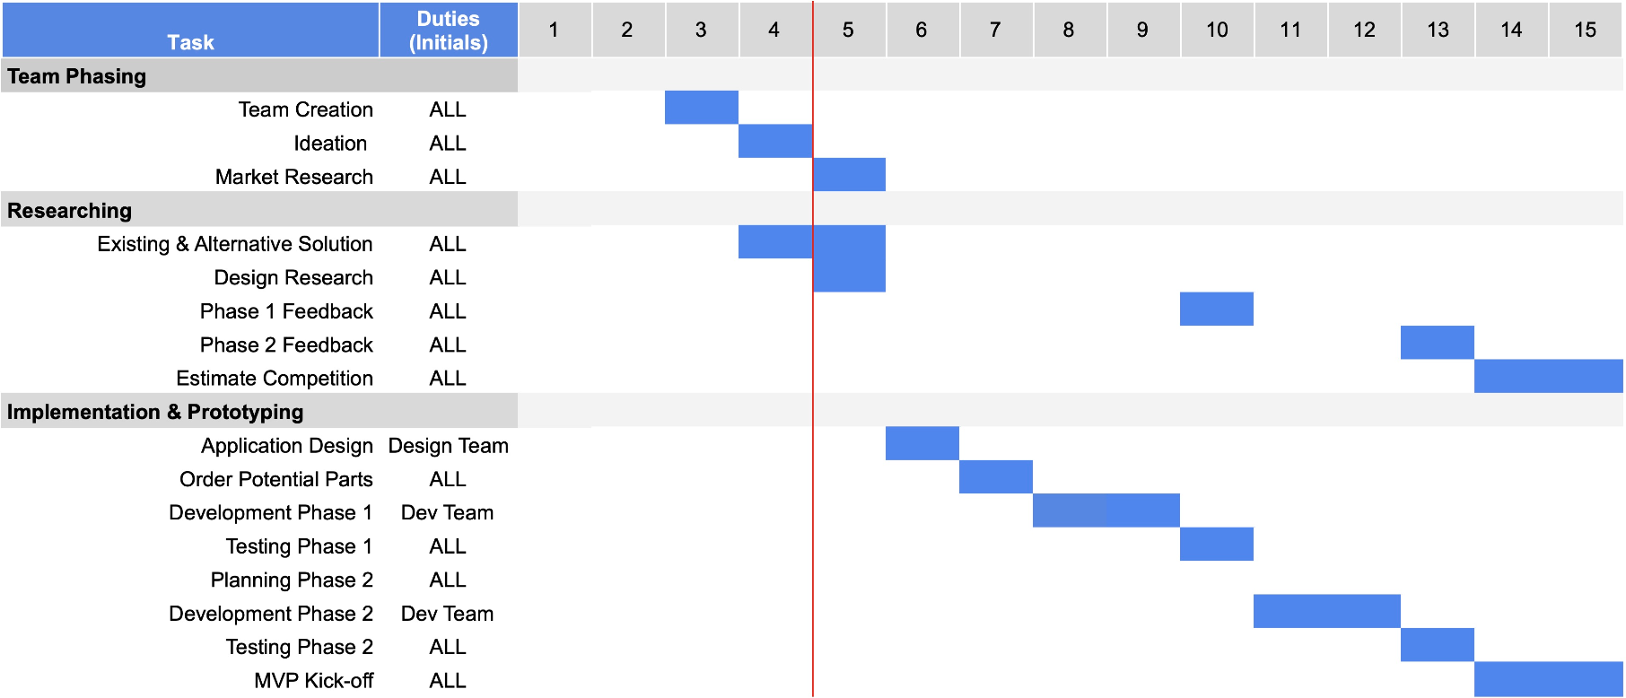
Planning

Slide 12

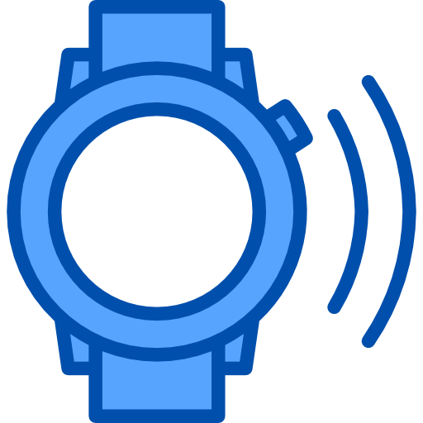
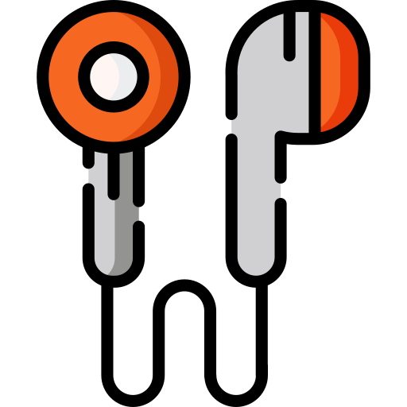
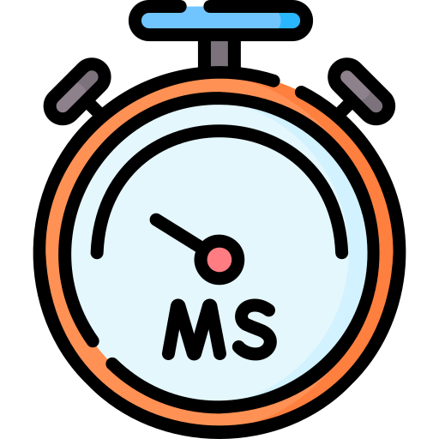
Evaluation Strategy & Success Criteria
Success criteria
Can the mobile application provide reasonable guides quickly?
Notify user when the pace changes
Provide “reasonable” guides
Requirements
It should not interfere with other applications (e.g. messenger, music player)
It should provide feedback promptly
It should consume small amount of battery (comparable to music player application..?)

Slide 13








Task Designation
Task Designation
Mobile App (watch & phone) | 길광연, 송재헌
UI/UX | 이상민
Model Training & Algorithms | 김영석, 손성욱

Slide 14
Thank You
송재헌 | steve2972@snu.ac.kr
손성욱 | sungwookson@snu.ac.kr
김영석 | kyssnu@snu.ac.kr
길광연 | gil9103@snu.ac.kr
이상민 | snuvistasy@snu.ac.kr

Slide 15
Q & A

Slide 16
Project Proposal Checkbox (DUE 9/27 23:59)
TODO | 담당자 | 완료
Target users and the problem they are facing | 재헌 | O
Existing solutions and their limitations | 재헌 | O
The key solution idea to tackle the problem | 상민 | O
Usage scenarios | 영석 | O
The proposed system overview and specific functions | 재헌/광연 | O
Expected (technical) challenges and solution ideas !! NOVELTY !! | 광연 | O
Evaluation strategy & Final deliverable and success criteria | 상민 | O
Overall project plan (Gantt Chart ?) | 성욱 | O

Slide 17





Mean Viable Product
Step 1: Run
Step 2: Collect
Data
Step 3: Training
Step 5: Improve
Step 4: Feedback

Slide 18
(notes)
Main problem:
Many users find it difficult to maintain an optimal pace for the duration of a run
Many factors including weather, current health conditions, terrain, etc. contribute to this difficulty
Existing running apps (Nike, Samsung Health, etc.) measure speed after a workout has ended
This leads to poor feedback during the actual exercise.
Many people do not know how long they should exercise for, with many losing motivation after a few weeks
Solution:
Create a pace-keeping application that monitors a user’s running speed and proposes an optimal pace based on micro/macro factors
Macro factors: target weight, target distance, previous time records, etc.
Micro factors: current terrain conditions (asphalt, incline, etc.), heart rate, etc.
Implement a game system to motivate users to reach their goals
Target audience:
Health-aware users who wish to augment their daily exercises with AI assisted jogging/walking routines
Professional runners who wish to closely monitor their running speed and improve their record times
Anyone who wants to lose weight through consistent exercise

Slide 19
System notes
Provide feedback: through earphones or vibration
Sensor Data
Smartphone
Galaxy 10
GPS, accelerometer, barometer, compass, gyroscope, proximity sensor, step counter, geomagnetic field sensor, ambient and device temperature sensor
Smartwatch
Galaxy watch 4
Physical: heart rate, ECG, thermometer, pulse oximeter
External: accelerometer, barometer, compass, gyroscope, ambient light, GPS
REDUNDANT => written in Key Solutions
Gather physical data using smart watch sensors
Use locational query data and smartwatch data to calculate optimal pace with ML
Optional: use data/ML to detect good running posture

